Slide 1

Healing the Heart
Addressing the Disparity Between Cardiovascular Prescription Utilization and Coverage
Team 1: Interdisciplinary Health Data Competition
Ben, Boyang, Lauren, Paul, William
Notes:
Slide 1: Hello, welcome to our presentation about “healing the heart” where we examine the disparity of the utilization of cardiovascular prescriptions and it’s coverage by insurance for Minnesotans.

Slide 2
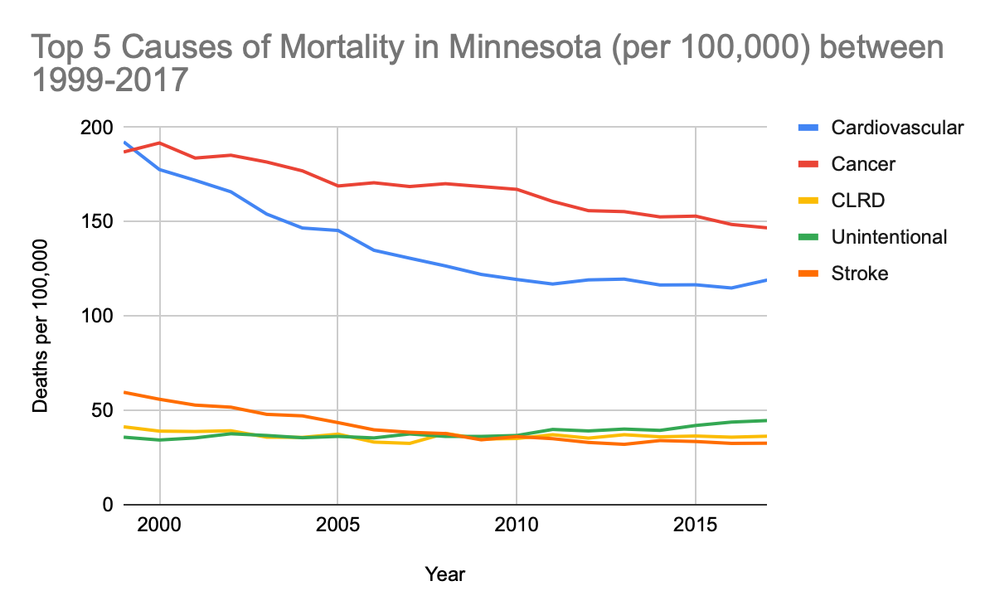


BURDEN OF CARDIOVASCULAR DISEASE IN MINNESOTA
BACKGROUND & MOTIVATION
METHODOLOGY
DATA
ANALYSIS
PROPOSED SOLUTIONS
Number two cause of mortality since 1999¹
Annual Cost of CVD hospitalizations in 2016 $720 Million
18% Minnesotans died of a heart attack in 2017²
Notes:
Slide 2: Over the last 50 years, as acute medical conditions have waned and as chronic disease has taken the attention of the medical community, cardiovascular disease has become one of the most prevalent cause of mortality in many developed nations around the world. In Minnesota, that is no different. According to the MN health department and the CDC, between 1999-2007, CVD has remained as the number 2 cause of mortality, just behind cancer, causing 18% of deaths of Minnesotans in 2017. It has a dramatic cost on Minnesota’s economy, costing patients approximately $720 million in hospitalizations each year since 2016.

Slide 3
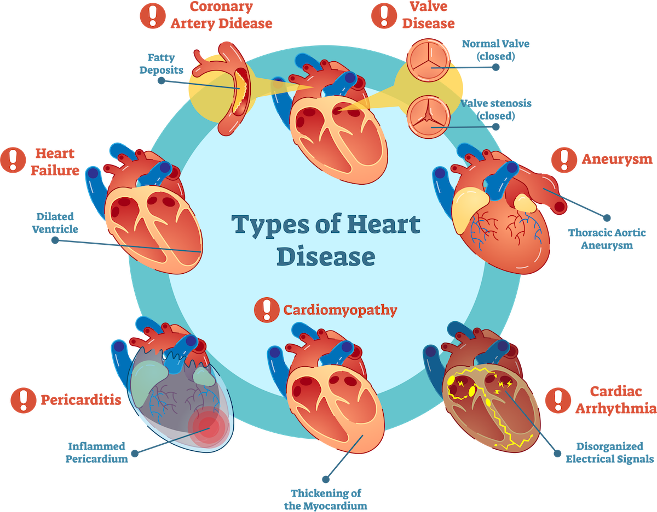
CARDIOVASCULAR DISEASE IS VARIED
BACKGROUND & MOTIVATION
METHODOLOGY
DATA
ANALYSIS
PROPOSED SOLUTIONS
Notes:
Slide 3: A cause of such a high portion of mortality caused by CVD is that multiple forms of CVD exist, therefore risk factors for CVD is also varied. Most common risk factors include obesity, diabetes, family history, smoking, high cholesterol, and high blood pressure. Other factors, such as low SES, high stress, and other environmental factors must be considered as well. Battling these factors is still an ongoing battle and subject of furious research throughout the United States. With so many factors to control, it goes to reason that are many pharmaceutical agents out there to meet those needs.

Slide 4
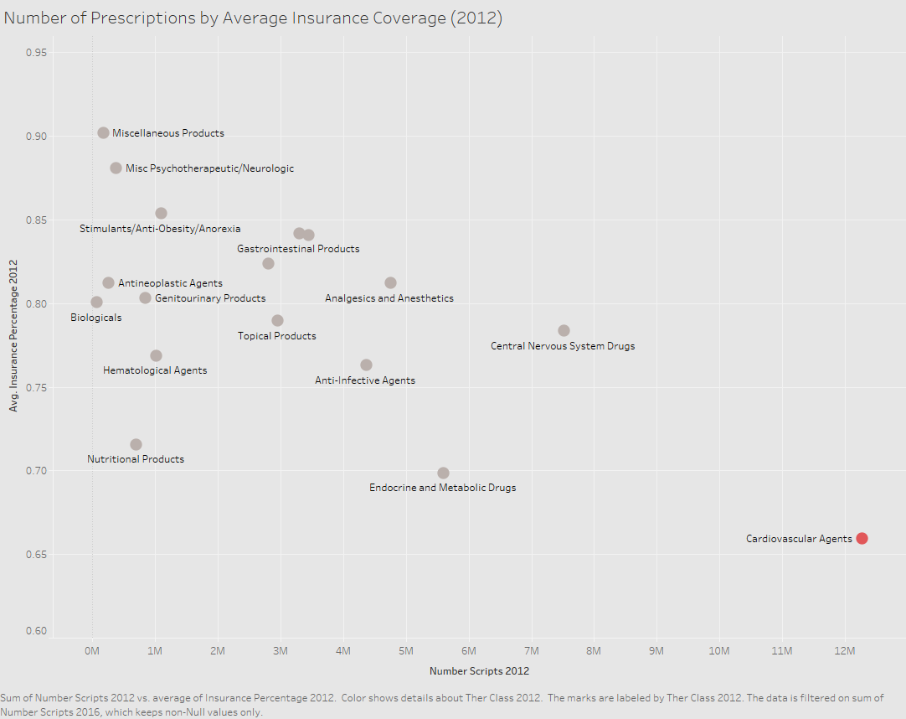
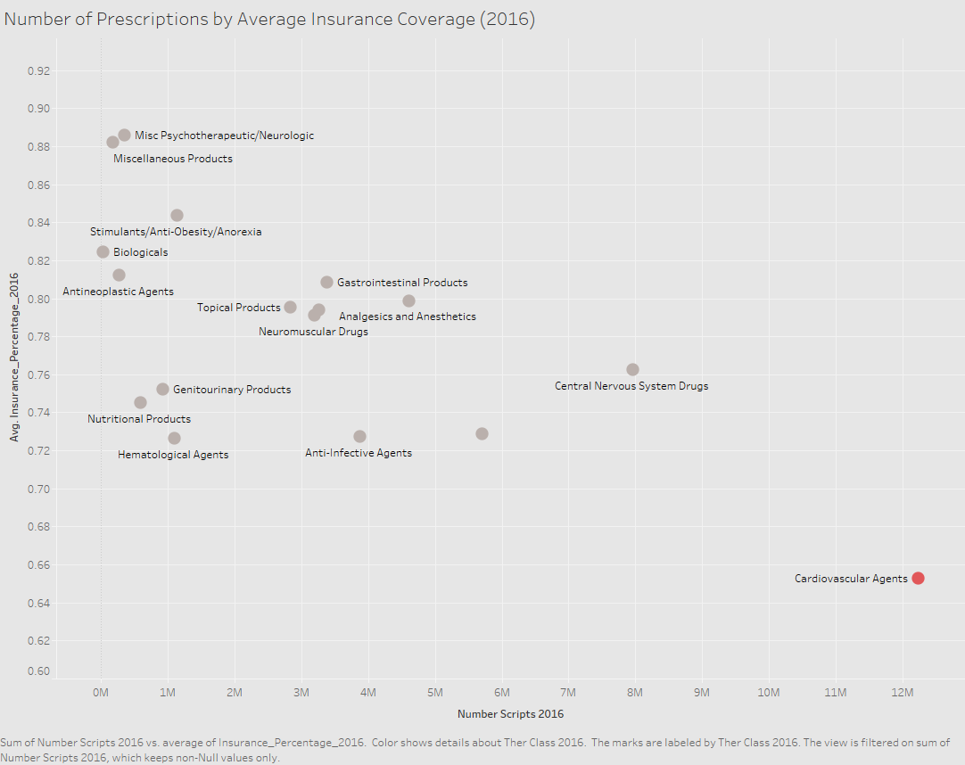
CARDIOVASCULAR AGENTS ARE THE MOST PRESCRIBED
BUT THE LEAST COVERED
BACKGROUND & MOTIVATION
METHODOLOGY
DATA
ANALYSIS
PROPOSED SOLUTIONS
Average Cardiovascular Insurance Coverage (2012): 65.92%
Number of Prescriptions (2012): 12,265,559
Average Cardiovascular Insurance Coverage (2016): 65.26%
Number of Prescriptions (2016): 12,226,831
Notes:
Slide 4: Which is why, we can see from the data that was provided for this competition that, CVD agents are, unsurprisingly, the most highly prescribed therapeutic class of medication. However, IT IS surprising to our group that CVD agents are actually the least covered in terms of median cost paid by insurance for the drugs. In both 2012 and 2016 there were approximately 12 million prescriptions for CVD agents, far and above the most prescribed compared to other therapeutic classes, but also the least covered. This is illustrated in a graph showing coverage vs prescriptions where CVD agents stand alone.

Slide 5
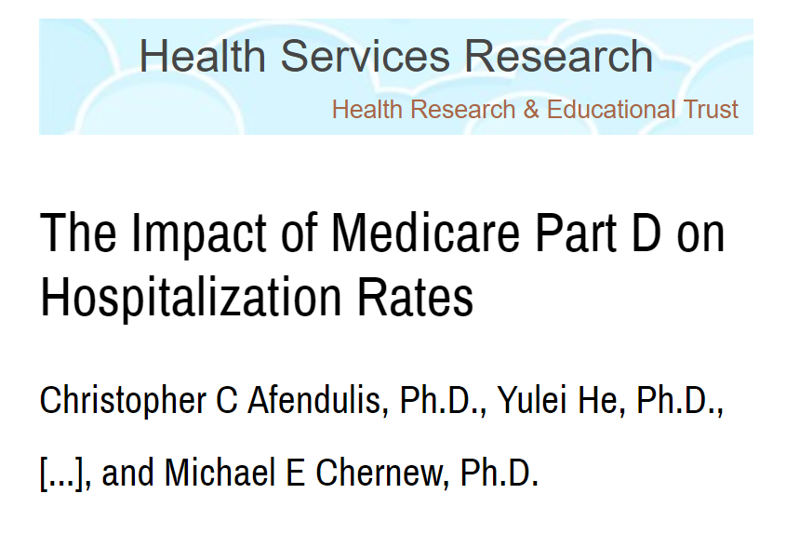
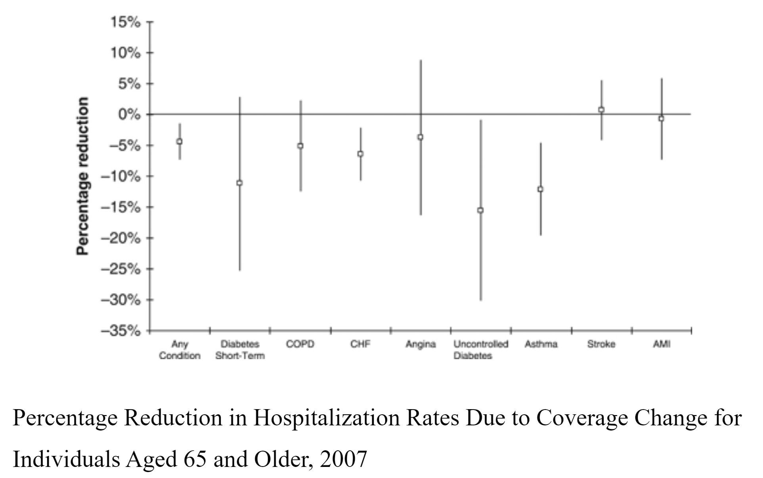
DRUG INSURANCE EXPANSIONS AND PATIENT HEALTH OUTCOMES
BACKGROUND & MOTIVATION
METHODOLOGY
DATA
ANALYSIS
PROPOSED SOLUTIONS
Initiation of Medicare Part D resulted in an increased in drug coverage among the elderly (23-state sample) 61% to 88%.
³
Notes:
Increase coverage to improve patient health outcomes, reduce hospitalizations
Looked at literature to see what could potentially be done to address disparities with coverage and utilization. Study by Afendulis et al shows the overall effect on Medicare part D initiation to hospitalization rates for diseases potentially manageable by medication. Overall, we see a 5% reduction in hospitalization rates due to increased coverage by initiation of Medicare Part D and for CV diseases specifically, we see a 5% and 7% reduction in angina and CHF respectively.

Slide 6
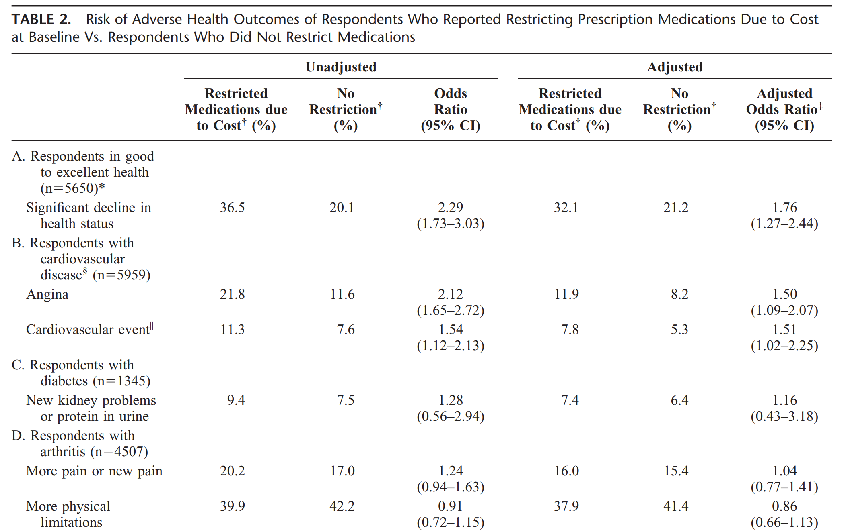
HEALTH EFFECTS OF RESTRICTING PRESCRIPTION MEDICATION COVERAGE
BACKGROUND & MOTIVATION
METHODOLOGY
DATA
ANALYSIS
PROPOSED SOLUTIONS
Heisler et. al (2004)⁴
Notes:
Conversely, another study by Heisler et al shows that restricting prescription medication coverage results in an increased risk in health outcomes. Specifically, we see that the adjusted odds ratio for health status, angine, CVD event, and new kidney issues were increased as a result of restricted prescription medication coverage.

Slide 7

What trends can we uncover that explains the disparity in cardiovascular drug coverage and what can we do to address it?
BACKGROUND & MOTIVATION
METHODOLOGY
DATA
ANALYSIS
PROPOSED SOLUTIONS
Notes:
So, given this disparity of utilization and coverage for CVD medications and the literature showing potential solutions to this disparity, our exploratory analysis focused on *read the slide* However, before we go into the results of our analyses, Boyang will first go over the characteristics of the data set we used and our methodology.

Slide 8


DATA SOURCES
BACKGROUND & MOTIVATION
METHODOLOGY
DATA
ANALYSIS
PROPOSED SOLUTIONS
Obtained from Minnesota All Payers Claim Database (years 2012 & 2016)
Contains information regarding a specific drug (launch year, ingredients, dosage)
40 features; 58,299 entries
Drug Details
Drug Summary
Contains information regarding drug characteristics (region distribution, age distribution)
50 features; 8,455 entries
Notes:
We first take a look at the data sources which are provided to us. The data was obtained from Minnesota All Payers Claim Database, and covered year 2012 and 2016. There are two tables provided. The first table contains information regarding a specific drug. There are features such as launch year, ingredients and dosage. There are 40 features and 58299 entries in total. The second table contains information regarding drug characteristics, including region and age distribution for people consuming certain type of drugs. There are 50 features and 8455 entries in total.

Slide 9



DATA CLEANING
NULLS
JOINS
BUILT
BACKGROUND & MOTIVATION
METHODOLOGY
DATA
ANALYSIS
PROPOSED SOLUTIONS
Impute nulls in ‘PROPNAME’
Drop rows with 10% missing
Join Drug Summary 2012 and 2016 data on 4 features
Join Drug Details 2012 and 2016 data on 6 features
Compute percent change between 2012 and 2016 in Drug Summary
Percentage of insurance coverage in Drug Details
Notes:
There are a few steps we did for data cleaning.
First, we impute some NA’s in column PROPNAME. According to the description, all generic drug has a value of NA, so we basically replaced NA with “generic”. In addition, we dropped some rows with 10% missing.
In addition, since each table has data for two years, we decided to join some based on certain features.
Drug Summary Join features: ['RECORD_TYPE','NPROPNAME', 'THER_CLASS','PAYER']
Drug Detail Join features: ['NDC9','PRODUCT_NDC', 'RECORD_TYPE','NPROPNAME', 'THER_CLASS’, 'PAYER']
Also, we built some columns for our analysis.
We added Percent Change for ‘COST_PER_SCRIPT’ and ‘COST_PER_SCRIPT_RANK’ to compare the growth or decline between 2012 and 2016.
And we also added percentage of insurance covered, which was calculated as insured_paid_sum / (insured_paid_sum + member_paid_sum)

Slide 10
CLUSTERING ALGORITHM SEPARATED DRUGS BY PAYER
BACKGROUND & MOTIVATION
METHODOLOGY
DATA
ANALYSIS
PROPOSED SOLUTIONS
ATTRIBUTES CONSIDERED
Drug Payer
Gender Distribution
Age Distribution
Area Distribution
Cluster 1
(104 Types)
100 % drugs belong to Commercial
Cluster 2
(106 Types)
100 % drugs belong to Medicare
Cluster 3
(72 Types)
100 % drugs belong to Minnesota Health Care Program
Notes:
For the first step of our analysis, we want to take a look at all cardiovascular drugs and see if there are any common patterns or groups within these drugs. The way we do it is through a clustering method, which will assign similar data points to the same group and assign different data points to a different group. The features we are using include the payer of the drug, the gender distribution, the age distribution (like if the person is 65 plus) and the area distribution (rural small town vs. urban). We decide used Silhouette (si lou ette)coefficient to decide the number of clusters. When k =3 , we obtained the highest silhouette value. So here are the result of 3 clusters. Surprisingly, we found out that clusters are neatly separated by drug payers.
For cluster1, 100% drugs belong to Commercial ...
We want to explore why drugs belongs to commercial are so different from drugs which belongs to medicare. We found out that there aren’t a huge difference in terms of gender and area distribution. But we found out that the age groups are quite different across different payers. so we looked more into the age group, and Will will share what we found.

Slide 11
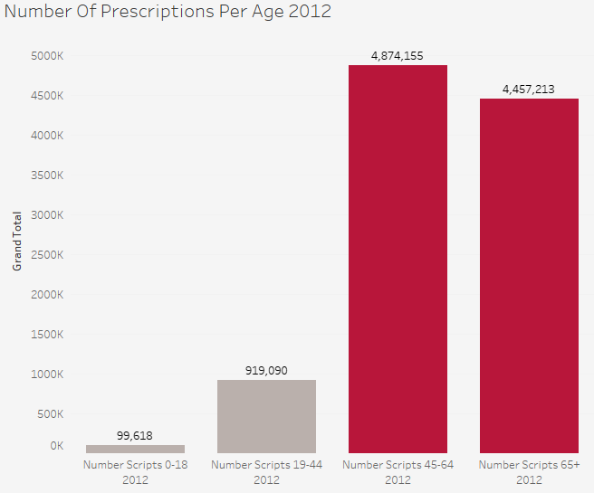
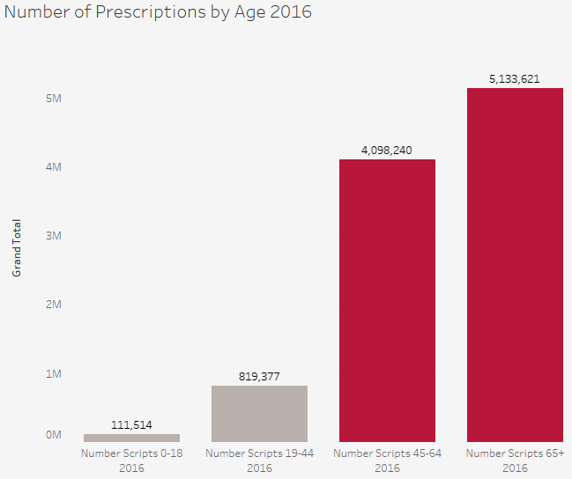
OLDER PATIENTS RECEIVE THE MOST CARDIOVASCULAR AGENT PRESCRIPTIONS
BACKGROUND & MOTIVATION
METHODOLOGY
DATA
ANALYSIS
PROPOSED SOLUTIONS
In 2012, the majority of cardiovascular prescriptions were given to the age group 45-65
In 2016, 65+ makes up the majority of prescriptions
Both groups are significantly higher than the younger patient groups
Notes:
When we explored age groups, we started by looking at a general idea of what age groups need the most cardiovascular treatment.
As we suspected, the majority of people who needed cardiovascular drugs tended to be the older populations
We saw that in 2012, the majority of prescriptions were given to people in the age group 45-64.
In 2016, the trend changes a bit, where the 65 and older population received more cardiovascular drugs
However, in both years, both groups receive a disproportionately high amount compared to the younger age groups, so we decided to look further into the aging population.

Slide 12
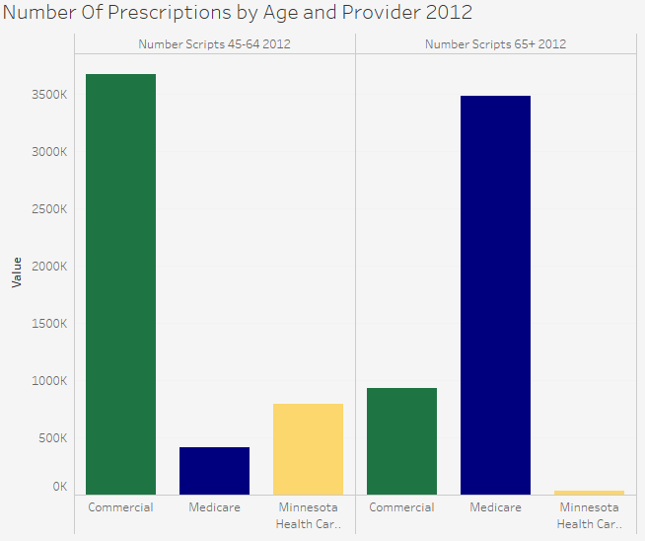
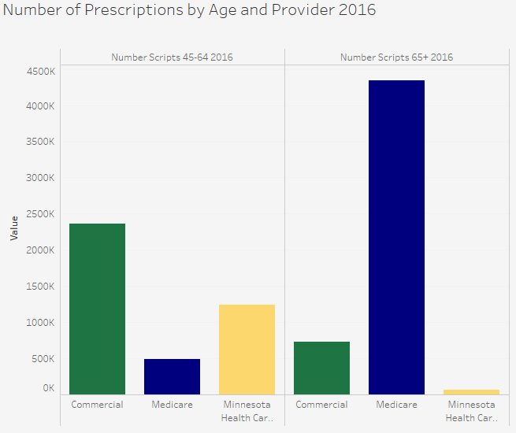
MEDICARE AND COMMERCIAL INSURANCE PROVIDE THE MAJORITY OF COVERAGE FOR THESE AGE GROUPS
BACKGROUND & MOTIVATION
METHODOLOGY
DATA
ANALYSIS
PROPOSED SOLUTIONS
Commercial is the primary payer for Patients Age 45-64
Medicare is the primary payer for Patients Age 65+
Trends are the same for both years
Notes:
Our next step was to determine how the people in the 45 and older groups were covered.
The trend is pretty much what we’d expect, with the people below 65 being covered by commercial until when they retire and become eligible for medicare.
In 2016, the trend is pretty similar to what we see here, but with less emphasis on commercial for the below 65 patients and more medicare for 65 and older group
Minnesota Health Care Programs follow a similar trend, but it’s less pronounced. We see it being used much less when patients become ineligible.

Slide 13
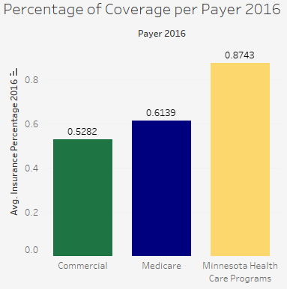
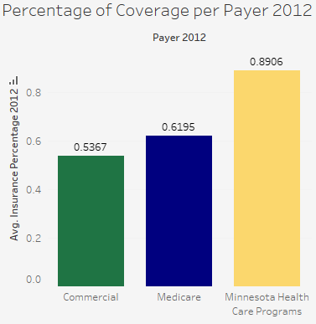
ONLY MINNESOTA HEALTH CARE PROGRAMS OFFER ABOVE AVERAGE COVERAGE
BACKGROUND & MOTIVATION
METHODOLOGY
DATA
ANALYSIS
PROPOSED SOLUTIONS
Average Commercial Coverage: 53.67%
Average Medicare Coverage: 61.95%
Average MCHP Coverage: 89.06%
Distribution is not significantly different between years
Percentages actually dropped in 2016
Notes:
Once we knew what payers the core demographic was using, we turned our attention to the amount of coverage those payers provided.
Looking at both commercial and medicare, these payers offer on average 54 and 62% coverage for cardiovascular drugs.
The coverage they offer is well below average, especially in comparison to the coverage they offer other costs
The percentage of coverage has not changed in the 4 years since 2012 and has actually decrease a little bit.
The lower amount of coverage is something we want to target in our recommendations.

Slide 14
WE RECOMMEND THAT THE STATE OF MN COVERS A PORTION OF OUT OF POCKET COSTS
BACKGROUND & MOTIVATION
METHODOLOGY
DATA
ANALYSIS
PROPOSED SOLUTIONS
Key Findings | Possible Courses of Action
Drug Payers are the Most Distinguishable Attribute Among Patients | Increased state subsidization of Cardiovascular Disease Medication costs
Patients Aged 45 and Older are the Most At Risk for Cardiovascular Issues | Increase and Expand Medicare Coverage to the Age 45-64 Age Group
Patients in this age group primarily use Commercial and Medicare Payer | Increase Accessibility and Eligibility for Minnesota Health Care Programs
Commercial and Medicare offer Below Average Coverage | Incentivize Increased Commercial Drug Coverage for patients Age 45+
Notes:
So to quickly summarize our key findings, our team learned that…… read off the slide
With these insights in mind we came up with the following courses of action
Read of the slide…..
Of these, we felt that the most feasible and beneficial solution is to increase state subsidization

Slide 15
Cost Benefit Analysis for Increasing State Subsidization
BACKGROUND & MOTIVATION
METHODOLOGY
DATA
ANALYSIS
PROPOSED SOLUTIONS
Benefits
Decreased costs associated with preventable hospitalizations
Increased economic activity (i.e increase employment and spending)
Lower overall costs for healthcare programs to the state
Better overall health for the population
Costs
Increased short-term spending by the MN government
Increased administrative burden
May decrease funding allocation for other programs
May decrease coverage of other payers
Notes:
Script: In order to put our analysis into a more meaningful perspective, we have chosen to do a cost benefit analysis. We believe there are multiple benefits that can come from increasing cardiovascular prescription coverage in Minnesota. First, we would expect a decrease in hospitalization costs. As with more coverage, there should be fewer individuals needing emergency medical care. Second, we would expect an increase in economic activity. When more prescriptions are covered for an individual, they have more money to go around. Third, we would expect a lower overall cost for healthcare programs in the state of Minnesota. Finally, and most importantly, with more prescription coverage the population will have a better overall health. Of course we also must acknowledge the costs in increasing cardiovascular prescription coverage in Minnesota. First, we realise there would be an increase in both short-term spending by the Minnesota government and an increased administrative burden. Similarly, due to an increase in spending, there will be decrease in funding for other programs.(There may also be a chance that other other payers would decrease their coverage contribution in response to the state increase)
Source: https://www-nejm-org.ezp1.lib.umn.edu/doi/10.1056/NEJMp1613981
https://www.health.state.mn.us/news/pressrel/2019/costs022819.html
Numbers show

Slide 16
Hypothetical Cost Benefit Analysis for MN
BACKGROUND & MOTIVATION
METHODOLOGY
DATA
ANALYSIS
PROPOSED SOLUTIONS
Over the course of 1 year...
Assume a 5% reduction in hospitalizations due to CVD³
The average cost of a CVD hospitalization is $16000⁵
There were 45000 hospitalizations due to CVD⁶
Benefits
45,000
45,000 x $16,000 x 5%
$36 Mil
45,000 x $16,000
Costs
$21.8 Mil
$109 Mil x 20%
State government covers 20% of out-of-pocket cost for cardiovascular medications
$109 Mil
Individuals pay on average $109 Mil for cardiovascular medications
$14.2 Mil Net Savings
Notes:
Script: To put these benefits and costs into a more realistic perspective, we performed a hypothetical cost benefit analysis using information obtained through research papers and the all payers claims database. Walk through math.
Source: https://www-nejm-org.ezp1.lib.umn.edu/doi/10.1056/NEJMp1613981
https://www.health.state.mn.us/news/pressrel/2019/costs022819.html (Source for total heart healthcare spending in MN in 2013)
https://www.health.state.mn.us/diseases/cardiovascular/data/heartdisease.html (Source for CVD hospitalizations in MN)
https://www.ncbi.nlm.nih.gov/pmc/articles/PMC5436769/ (Source showing cost of CVD hospitalization in USA)
Numbers show

Slide 17



CAVEATS
COST BURDEN
ADHERENCE
LIMITED DATA
BACKGROUND & MOTIVATION
METHODOLOGY
DATA
ANALYSIS
PROPOSED SOLUTIONS
Knowing cost burden could help determine whether or not possible lack of medication adherence is related to cost
With the given data, we cannot be certain if lack of medication adherence is a primary risk for CVD
With only data for two years (2012 and 2016), any causal assumptions are limited in scope
Notes:
Script: While we have already stated the recommendations and net savings of implementing them, we would like to acknowledge the potential caveats of our analysis. We have identified three primary caveats: cost burden, adherence, and limited data. First, knowing the cost burden could help to determine whether or not a possible lack of medication adherence is related to cost. Simply, are people not taking the prescribed medications due to the cost of the drug. Second, with the given data we cannot be certain if this lack of medication adherence is a primary risk for CVD. Finally, the all payers claim database cover two years, 2012 and 2016. In order to do any causal analysis assumptions would need to be made. These assumptions are limited in scope because of the construction of the database.

Slide 18
PREVENTION MATTERS
BACKGROUND & MOTIVATION
METHODOLOGY
DATA
ANALYSIS
PROPOSED SOLUTIONS
Healthy Routines
Medical Access
Healthy Diet
Improved
Heart Health
Notes:
Script: Regardless of these caveats, prevention matters. Medical Access is only one way to improve heart health. To reduce the likelihood of CVD, individuals should participate in healthy routines such as exercise and a healthy diet. While individually, these components will improve heart health, the best solution is to include all components in the daily life.
Source 4: https://www.cdc.gov/heartdisease/prevention.htm
Source 5: https://www.ncbi.nlm.nih.gov/pmc/articles/PMC4318289/
Source 6: https://www.ncbi.nlm.nih.gov/pmc/articles/PMC4602927/
Despite the many risk factors of CVD, evidence shows can be prevented through regular check ups/health maintenance, regular exercise, and a healthy diet. Especially important for medicinal and regular preventative medical care is insurance. Which has been shown to better outcomes for CVD.

Slide 19
CONCLUSION
PROBLEM
INSIGHTS
SOLUTION
BACKGROUND & MOTIVATION
METHODOLOGY
DATA
ANALYSIS
PROPOSED SOLUTIONS
There is a disparity between Cardiovascular Drug Usage and Insurance Coverage
The disparity is most apparent for patients 45+ with either commercial or Medicare coverage
Addressing the disparity by increasing CVD prescription coverage for this at risk population may increase health outcomes and reduce costs
Notes:
Script: In conclusion, we found that there is a disparity between cardiovascular drug usage and insurance coverage. This disparity is morst apparent for patients age 45 or older with either commercial or Medicare coverage. To reduce the disparity, we recommend increasing CVD prescription coverage for this at risk population. This may increase health outcomes and reduce costs. This recommendation in combination with a healthy lifestyle and diet will benefit the state of Minnesota as a whole.

Slide 20
THANKS!
Interdisciplinary Health Data Competition
Team 1:
Ben, Boyang, Lauren, Paul, William

Slide 21
REFERENCES
[1]Tejada-Vera B. Leading Causes of Death: United States, 1999–2017. National Center for Health Statistics. 2019. Designed by B Tejada-Vera, L Lu, E Arias, JM Keralis, and Y Chong: National Center for Health Statistics.
[2]National Center for Health Statistics. Vital statistics data available. Mortality multiple cause files. Hyattsville, MD: National Center for Health Statistics.
[3]Afendulis, C. C., He, Y., Zaslavsky, A. M., & Chernew, M. E. (2011). The Impact of Medicare Part D on Hospitalization Rates. Health Services Research, 46(4), 1022–1038. doi: 10.1111/j.1475-6773.2011.01244.x
[4]Heisler, M., Langa, K. M., Eby, E. L., Fendrick, A. M., Kabeto, M. U., & Piette, J. D. (2004). The Health Effects of Restricting Prescription Medication Use Because of Cost. Medical Care, 42(7), 626–634. doi: 10.1097/01.mlr.0000129352.36733.cc
[5]Kilgore, M., Patel, H., Kielhorn, A., Maya, J., & Sharma, P. (2017). Economic burden of hospitalizations of Medicare beneficiaries with heart failure. Risk Management and Healthcare Policy, Volume 10, 63–70. doi: 10.2147/rmhp.s130341
[6]MN Hospital Uniform Billing (UB) Claims Data, Health Economics Program, MDH and Minnesota Hospital Association.

